Slide 1
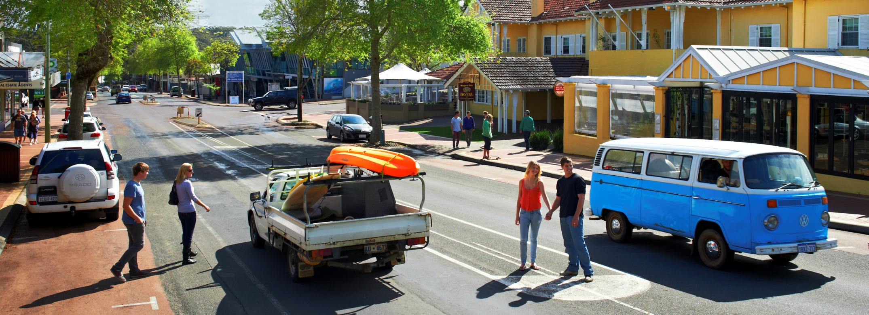
AMRTA DESTINATION MARKETING PLAN & STRATEGY 2014-2015
Presented by Simon Latchford, Group Marketing & Destination Development Manager

Slide 2
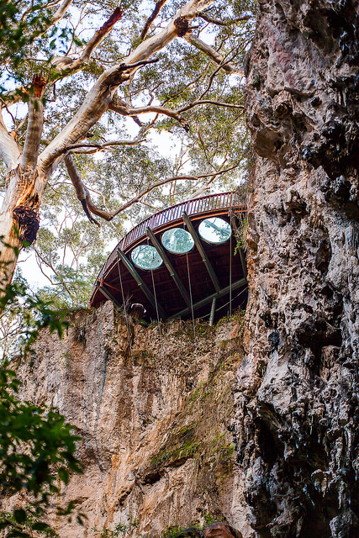
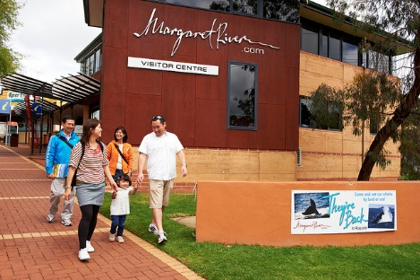
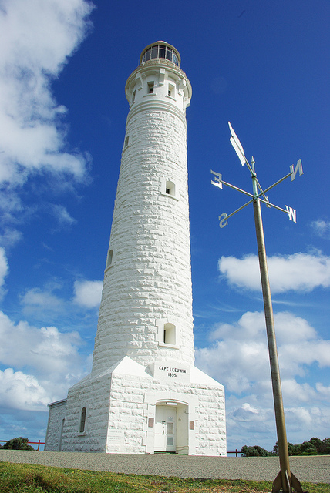
2014-2015 Destination Marketing Plan & Strategy
Our Story
The AMRTA established in 1957, as not for profit, self -funded organisation
Aim: destination promotion of the Margaret River Region for the benefit of local business, community and industry
Funds are generated through key operations, visitor servicing & attraction management including Lake, Mammoth, Jewel and Moondyne Caves and the Cape Leeuwin Lighthouse
Margaret River Region has become an iconic, world class destination

Slide 3
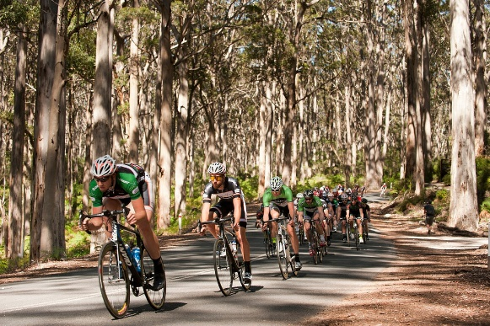
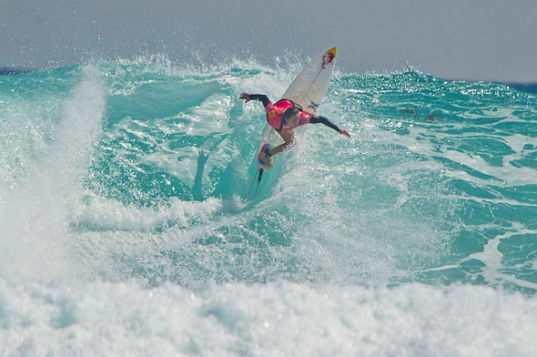
2014-2015 Destination Marketing Plan & Strategy
Destination Marketing Introduction
2014/15 AMRTA Destination Marketing Strategy Outlines:
Current AMRTA Destination Marketing team
Market challenges
Relevant market snapshot, partnership and stakeholder planning
Define Key Deliverables and Key Messages
Prioritise growth strategies for:
Margaret River.com brand
Visitation numbers
Visitor expenditure
Our vision is to position Margaret River as:
A leading WA regional destination in Asia/Pacific region
A significant contributor to the South West’s economy
Providing a range of experiences and an environment that supports the needs and interests of visitors from domestic and international growth economies

Slide 4
2014-2015 Destination Marketing Plan & Strategy
2014 Marketing Team Re-Structure
The AMRTA’s Destination Marketing Team has rolled out a team restructure to better resource trade and consumer strategy, planning and implementation objectives of the organisation.
Team Overview
Simon Latchford – Group Marketing & Destination Business Development
Victoria Johnson – Marketing, Media Communications Co-Ordinator
Christian Bishop – Digital Manager
Johanna Hamilton – Partnership Manager
Michelle Jacobsen – Member Support Consultant

Slide 5
2014-2015 Destination Marketing Plan & Strategy
Market Challenges
Inconsistent regional branding & duplication of activities
AMRTA – no funding from state government
No local industry development award process to benchmark industry standards
The need to attract investment for new product and experiences, and the need for existing operators to regularly re-invest in their product
Low number of operators with online booking facilities/operators blocking out key dates to screen online bookings
Seasonality lack of winter/low season strategies and campaigns for increasing visitation
Seasonality - small business operators leave for the winter
Language and cultural needs of international growth markets
Margaret River is a self-drive market- challenge for increasing Chinese visitation
Limited “international brand” large accommodation properties with identity

Slide 6
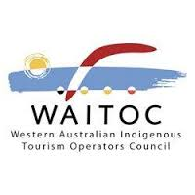
2014-2015 Destination Marketing Plan & Strategy
Partnership & Stakeholder Planning
Key consideration: ensure the integrity of the Margaret River brand is maintained
Strategic Alliances:
South West Development Commission (SWDC)
Western Australia Indigenous Tourism Operator Council (WAITOC)
Margaret River Wine Association (MRWA)
Southern Forests Food Council
Chung Wah Association, Perth
Partnership Management:
Partnership Manager role, filled by Johanna Hamilton, key to developing corporate partnerships and servicing key stakeholder management
Develop strong rapport with members and form trusting business relationships
Go-between role between the Destination Marketing Team and the industry
Promote member services, attract revenue, advertising and co-operative marketing

Slide 7
2014-2015 Destination Marketing Plan & Strategy
Partnership & Stakeholder Planning
South West Development Commission (SWDC)
This valued partnership and it’s inter-relationship with other industry stakeholders will underpin the Augusta Margaret River region growth objectives
SWDC’s 2013 – 2018 plan has measurable objectives that focus on infrastructure, events and wholesale/packaging
Short and long term planning strategies for their outlined *core tourism experiences of wine and food, biodiversity, art & culture and events compliment the AMRTA strategic plan
Develop and promote the South West region as a film location destination
Premium brand message of Margaret River as an aspirational visitor location

Slide 8
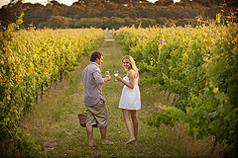
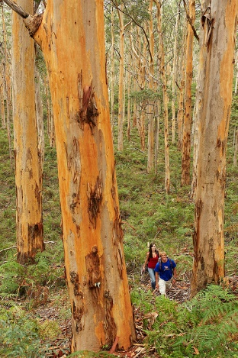
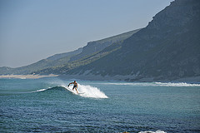
2014-2015 Destination Marketing Plan & Strategy
Key Deliverables & Objectives
AMRTA Attractions 40%
Destination Awareness 40%
Development 20%
Key Brand Messages
Attraction & Tours
Nature & Adventure Tourism
Food, Wine & Beer
Events
Arts & Culture
Goal: Increase product sales across all segments to build equity in our Key Brand Messages

Slide 9
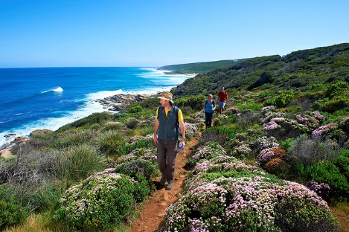
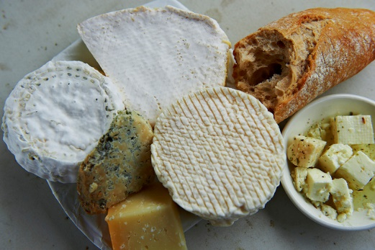
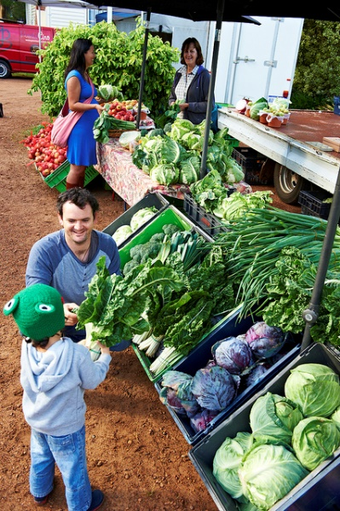
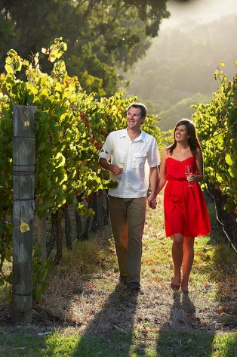
2014-2015 Destination Marketing Plan & Strategy
Development Overview
Product Segment Strengths
Beauty of natural environment
Margaret River region wine industry
Local boutique food producers and markets
Annual events
Engaged and innovative creative community with Open Studios promotion
Rich live music culture
Development Sectors
Arts
Youth & Adventure Market
Health & Wellness
Cycling
VolunTourism

Slide 10
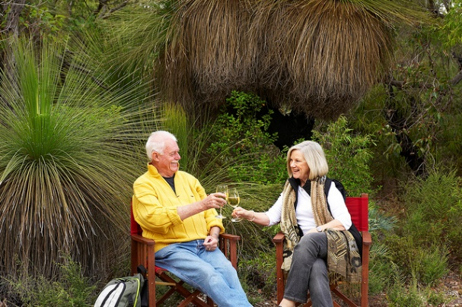
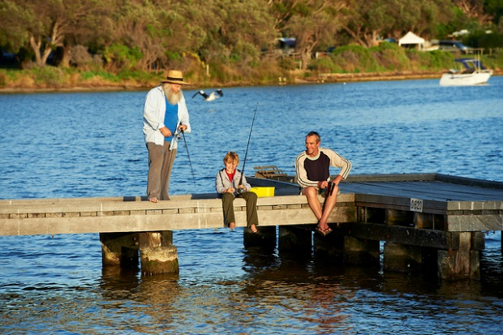
2014-2015 Destination Marketing Plan & Strategy
Target Market Overview
Domestic
High regional dispersal rate with 65 per cent of visitors originating from Perth
Western Australian's travel around their own state either for holiday/leisure purposes or to visit friends and relatives
Interstate Market
Aspirational Achievers - Something a little different where they can experience new things
Family Connectors - When holidays come along it's nice for everyone to slow down a bit and actually spend some time catching up with one another

Slide 11
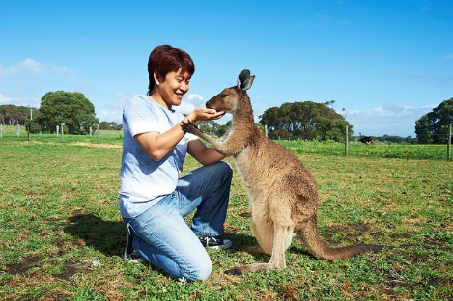
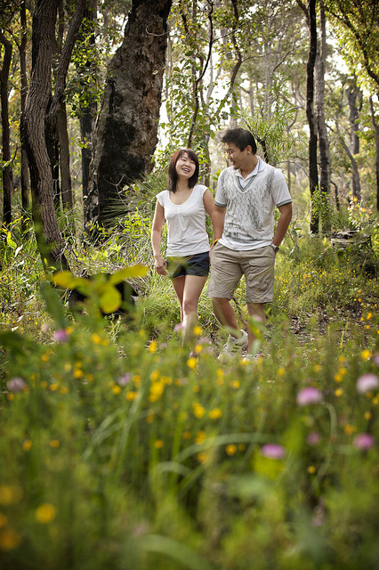
2014-2015 Destination Marketing Plan & Strategy
Target Market Overview
International
Singapore
Malaysia
Indonesia
NZ
Germany
UK/Other Europe
USA
China
Asian Market Insights and Opportunity
WA/Margaret River’s proximity to the Asia-Pacific presents an unparalleled opportunity to attract a growing middle class across key tourism visitor segments: leisure/holiday, business and visiting friends & relatives (VFR)

Slide 12
2014-2015 Destination Marketing Plan & Strategy
Regional Dispersal
#2 rank in the ‘Top 10 Places to Visit in Western Australia’
2nd behind Fremantle with 855,000; significant YOY increase of +18.6
Measurement of the AMRTA marketing activity effectiveness is challenging as Australia’s South West, Geographe Bay Tourism Association (GBTA) LTO and Augusta Margaret River Tourism Association LTO are all active in all markets and segments
Regional branding project in current review will look to consolidate future brand representation for the region
Brand ideal:dissolve confusion in key source markets, eliminate duplication of destination marketing spend, generate a higher penetration of one regional brand in traditional and emerging markets to increase yields for tourism product
Positive growth in 2013: Regional Dispersal figures for the Australia South West have increased overall from 2012 to 2013 with total visitor numbers and total visitor nights up 13.8% and 15.2% respectively

Slide 13
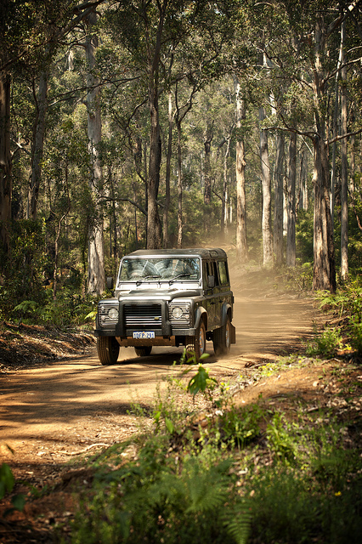
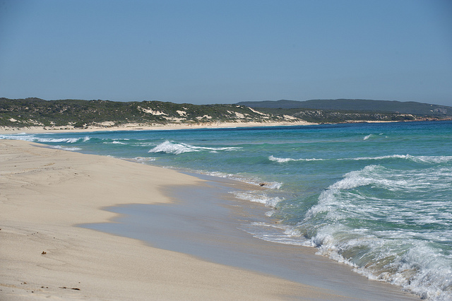
2014-2015 Destination Marketing Plan & Strategy
Asia Market Trends
Core challenge for Margaret River region as a leisure visitor destination is the metrocentric holiday behaviour of the Chinese holiday/leisure market
Natural environment is at the heart of Australia’s comparative advantage
Huge opportunity to for region to build specific marketing itineraries that are both appropriate and attractive to Asian group and independent travellers
Non-Asia International Markets
Western international leisure visitors to Australia spent 39% of their nights outside the Sydney, Melbourne, Brisbane/Gold Coast and Perth regions

Slide 14
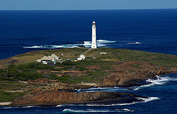
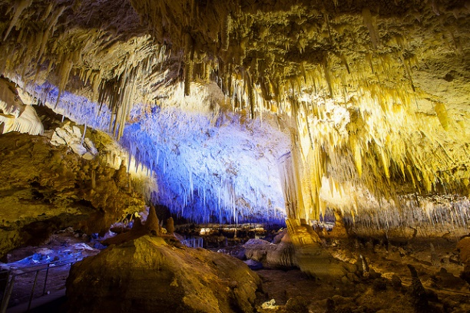
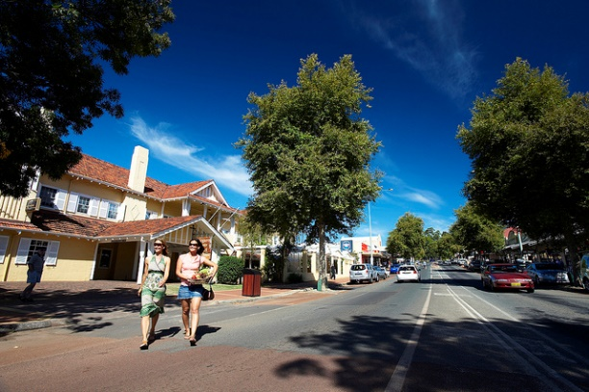
2014-2015 Destination Marketing Plan & Strategy
Marketing Plan Overview
Objective: to increase brand awareness for Margaret River Region and to overall increase visitation, increase length of stay and increase expenditure
The Marketing Plan activity is planned with two core targets:
Trade
Consumer
All planned activity represents a trade or consumer target against our Key Deliverables

Slide 15
2014-2015 Destination Marketing Plan & Strategy
Trade & Consumer Show Overview
KEY DELIVERABLES | CHANNEL | CO-OP | MARKET | STRATEGIES and ACTIVITY | MONTH
Destination Marketing | Consumer | ASW | Intrastate | Caravan Camping - Perth | March
 |  | ASW | Interstate | Caravan Camping - VIC | March
 |  | ASW | Interstate | Caravan Camping - NSW | Apr/May
 |  | ASW | Interstate | Caravan Camping - QLD | June
 |  | ASW | International | NATA - Singapore | March
 |  | ASW | International | MATTA - Malaysia | March
 | Trade | ASW | International | Australian Marketplace - USA | March
 |  | ASW | International | FTI Tourisktik Mega Famil & Workshop German Market | April
 |  | ASW | International | UK
 |  | ASW | International | ETE Perth | August
 |  | ASW | International | China Sales Mission | October
 |  | ASW | International | Indonesia Sales Mission | October
 |  | ASW | International | NZ Roadshow | November
 |  | AMRTA | International | Ni Hao WA | March
 |  | AMRTA | International | ATE Cairns | May
Table 1.8 – Trade & Consumer Co-Operative Marketing Activity ASW

Slide 16
2014-2015 Destination Marketing Plan & Strategy
Trade Activity by Target Market
Intra-state
Member product and industry development
Product Training – wholesale inclusions - ASW
Famils – Industry
International
Product Training – Industry Shows – ASW – Key Source Markets & AMRTA China
Famils – Industry
Partnerships/Product Development
Tourism Australia
TWA
ASW
GBTA
Industry Accreditation
Industry Associations
Airlines
Tour Operators
Wholesalers

Slide 17
2014-2015 Destination Marketing Plan & Strategy
Consumer Activity by Target Market
Domestic Markets
TVC Campaign – WA and National
June-Aug: National
Nov-Dec: Christmas
Feb-Mar: Easter
Press
Radio – Destination, Whale Season, Attractions
May-Aug
Nov-Dec
Feb-Mar
Cinema – VFR
Print – Media
Good Food & Wine – Perth – July
Digital
Camping & Caravan Shows – Perth, VIC, NSW, QLD, SA
Wedding – print, TVC, expo
MRGE
Surf Pro
Travel Shows – Co-op ASW
Food & Wine Events - AMRTA
Direct – website - BookEasy

Slide 18
2014-2015 Destination Marketing Plan & Strategy
Consumer Activity by Target Market
International markets
Singapore – Print, NATAS, MRGE & Airlines
Malaysia – Print, MATA & Air Asia
Indonesia – Road Show in Nov, Print & Garuda
NZ – Mondo, Air NZ, MRGE
Europe – TWA, ASW & ATE
USA – Australian Marketplace, ASW
UK – ASW
China – Sales Mission in Oct
Ni Hao WA – Perth March 2015
ATE 2015 – Melbourne June
ETE 2014 – Perth

Slide 19
2014-2015 Destination Marketing Plan & Strategy
Public Relations
Distribute AMRTA Trade and Consumer Press Release information to 300+
Work with key stakeholders in the region, international event teams & members
Focus on supporting the Destination Marketing Strategy
Familiarisations
1 media famil per month
Target breakdown by market:
8 domestic famils inc NZ (8 domestic return flights)
4 international famils (4 international flights for Singapore/Indonesia/Malaysia)
Develop Trade Partnership Agreements with domestic carriers to maximize the trade and media familiarization budget - Virgin Australia

Slide 20
2014-2015 Destination Marketing Plan & Strategy
Industry Development
Launch of local tourism industry awards in collaboration with Margaret River Chamber of Industry and Commerce: Margaret River Region 2014 Business Awards
Engaged NicolaJean Communications
Offers mentoring
Identify areas for growth to strengthen our product offering for premium visitor experiences in the region
Supports industry engagement and creates new relationships with the broader business community

Slide 21
2014-2015 Destination Marketing Plan & Strategy
Destination Next TVC

Slide 22
2014-2015 Destination Marketing Plan & Strategy
Virgin TVC

Slide 23
2014-2015 Destination Marketing Plan & Strategy
Tour of Margaret River

Slide 24
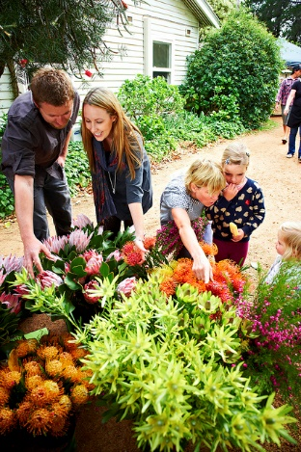
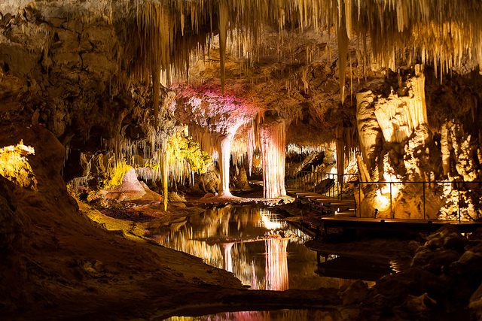
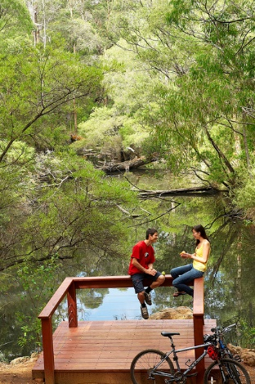
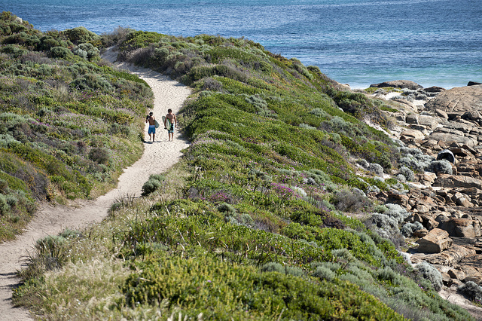
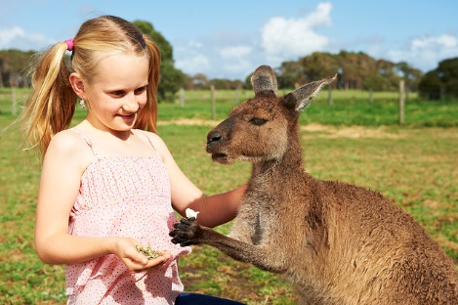
2014-2015 Destination Marketing Plan & Strategy
THE END
Thank you for your support!

